Slide 1


Micro Enterprise Supports
Audrey Coyne
LEO Dublin City
7th March 2019

Slide 2



What is the Local Enterprise Office…
Dublin City Enterprise Board
Dublin City Council
Local Enterprise Office

Slide 3













Joined up thinking… first stop shop for Enterprise Supports

Slide 4



1st Stop Shop for Business
Hard Supports
Soft Supports

Slide 5

Mentoring & Business Advice
Business Advice Clinic
Mentoring 3 hours (€50)
Mentoring 6 hours (€100)
Web: www.localenterprise.ie/DublinCity

Slide 6
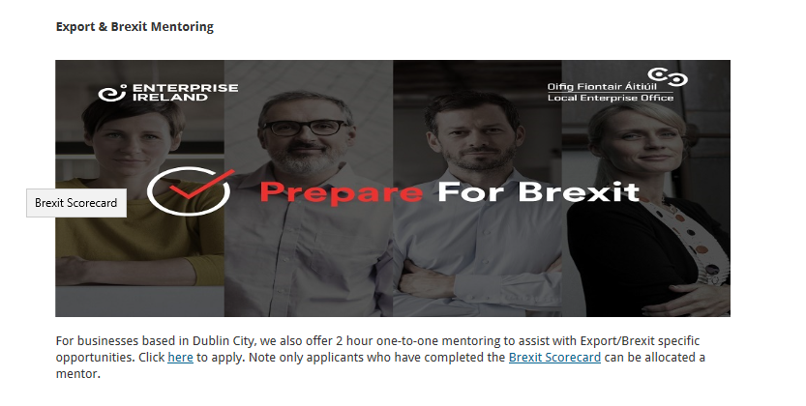

Slide 7

Training
Start Your Own Business Course
Book Keeping
Social Media and Online Marketing
Tax for SME’s
Recruitment
Negotiation

Slide 8




Advanced Training
Hi Start
This programme assists ambitious early stage growth focused companies to identify & build foundations to secure investment & scale the business in international markets.
Lean for Micro
This programme is aimed at owners/managers of small businesses who wish to gain an introduction to lean concepts
Accelerate
This programme provides the owner/manager with the management, leadership, business skills and knowledge to achieve sustainability.
Building Craft and Enterprise Design Programme
Craft and Designer makers - product development, digital marketing, branding

Slide 9
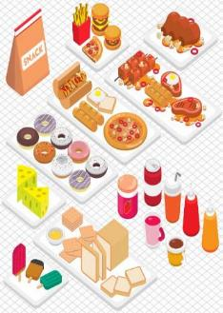
Food Training Programmes
      Digital Schools of Food
      Must complete 3 out of 8 modules before commencing Food Starter Programme
      Food Starter Programme
      Short two day programme designed to help those with a food idea or at very early stage of starting up a food business
    Food Academy Programme
Extensive training programme aimed at supporting and nurturing start-up food businesses

Slide 10
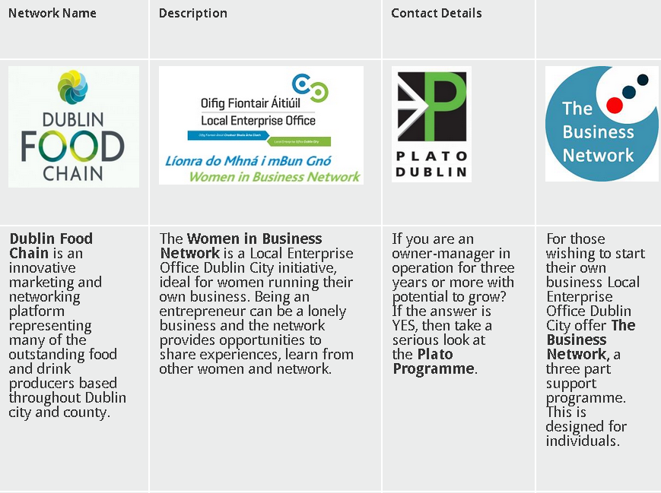

Slide 11

Ireland’s Best Young Entrepreneur Awards 2019
Open to anyone between 18 and 35 years old at time of application
€2 million investment fund
Apply at www.ibye.ie
Closing date is the 15th of March 2019

Slide 12

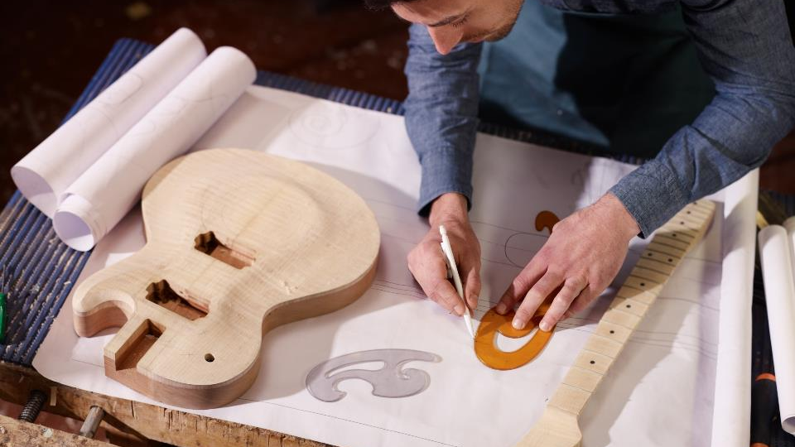
Let’s talk Finance!

Slide 13
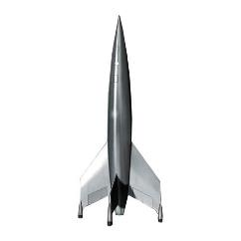
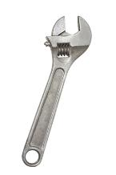

Expansion
Feasibility
Priming

Slide 14
LEO FINANCIAL SUPPORTS
Contract : 1 year from date of approval
Feasibility Grant Assist with researching market demand and sustainability of product/service Eligible Costs: Consultancy Patent Costs Prototype Market Research Covers 50% of spend Max €15k | Priming Grant Businesses < 18 months trading Eligible Costs: Salary Must include 1 new Full Time job | Business Expansion Grant Businesses > 18 months trading 30% Refundability Eligible Costs: Salary Must include 1 new Full Time job
www.localenterpriise.ie/dublincity

Slide 15

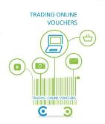

Export Assistance
Micro Finance Ireland
Trading Online

Slide 16

Trading Online Voucher
Purpose: To encourage small businesses to sell online
Cost of E commerce Website Development
50% of expenses up to a maximum of €2,500
Must be trading for 12 months
Compulsory Half Day Workshop

Slide 17
TAME Assistance
Technical Assistance for Micro Exporters
Purpose: Assisting to develop New Market Opportunities abroad
Eligible expenses:
Participation at international trade fairs and shows
Participation at international trade networking events
Development of specific Marketing Materials aimed at exploring new export markets
Travel, accommodation etc
50% of expenses up to a maximum of €2,500

Slide 18
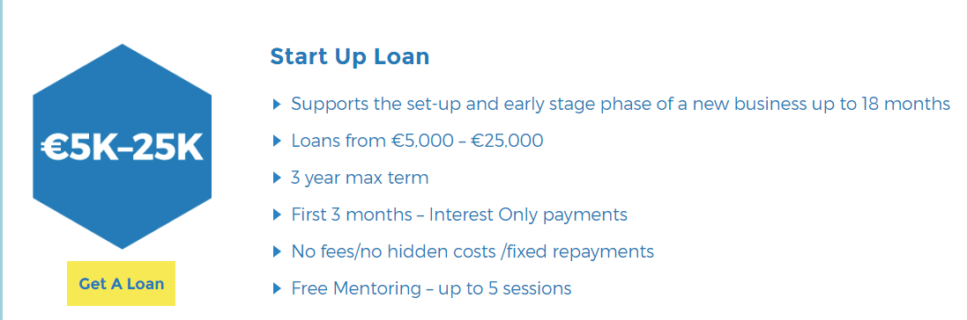
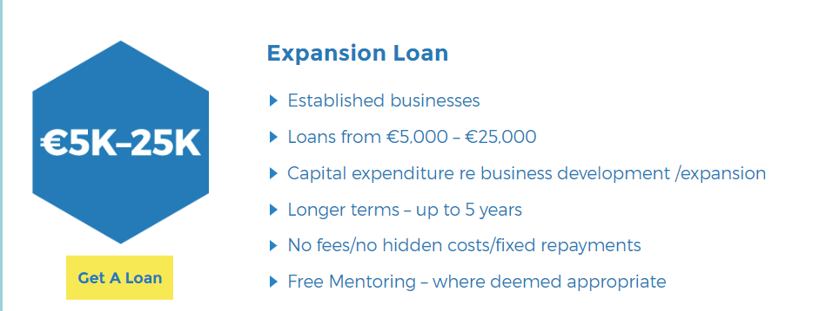
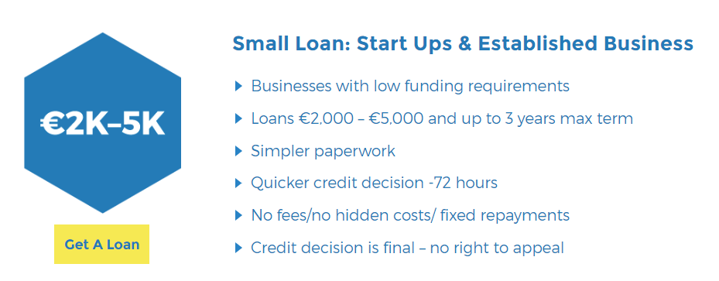
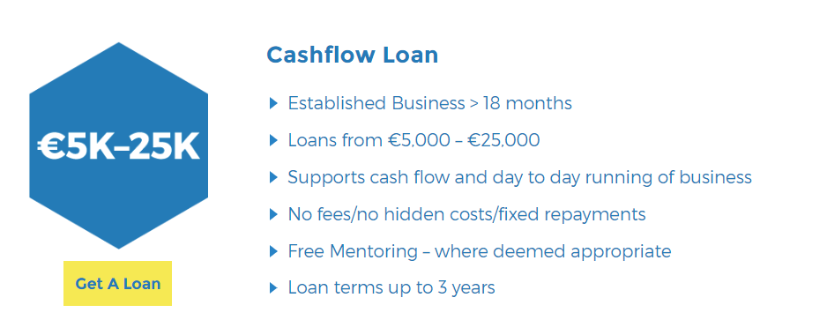
LEO Microfinance Loan Scheme (MFI)
Microenterprise Loan Fund Scheme

Slide 19
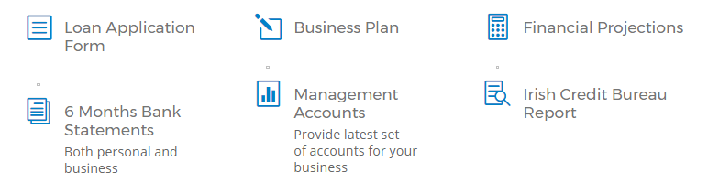
  New & Existing businesses with less than 10 employees and an annual turnover of up to €2M
  All types of businesses are eligible:
      Sole Traders
      Partnerships
      Limited Companies
  Creating/sustaining a minimum of one job
Who can Apply
What’s Required

Slide 20
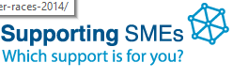
SME Online Support Tool
There are over 170 different Government supports for Irish start-ups and small businesses.
Supportingsmes.ie
By answering the eight quick questions in the Online Tool, a small business will, in one location be able to find out which support suits your business:
www.supportingsmes.ie

Slide 21
Sign Up for Our Newsletter
#MakingitHappen
Audrey Coyne
Local Enterprise Office Dublin City
Tel: 01 222 5611
Email: info@dublincity.ie
Twitter @LEODublinCity
Facebook: Local Enterprise Office Dublin City
Web: www.localenterprise.ie/DublinCity

